Slide 1
Istrobotics
Robotour 2018, 16.9.2018 Pavol Boško, Peter Boško, Radoslav Kováč, Tomáš Kováč, Ivana Kováčová

Slide 2
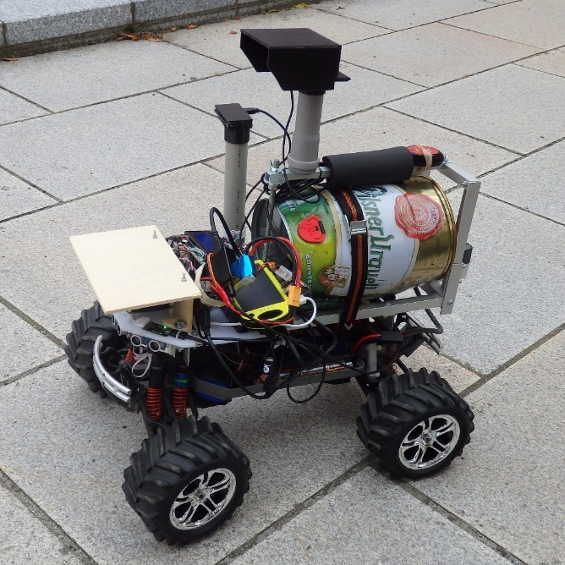
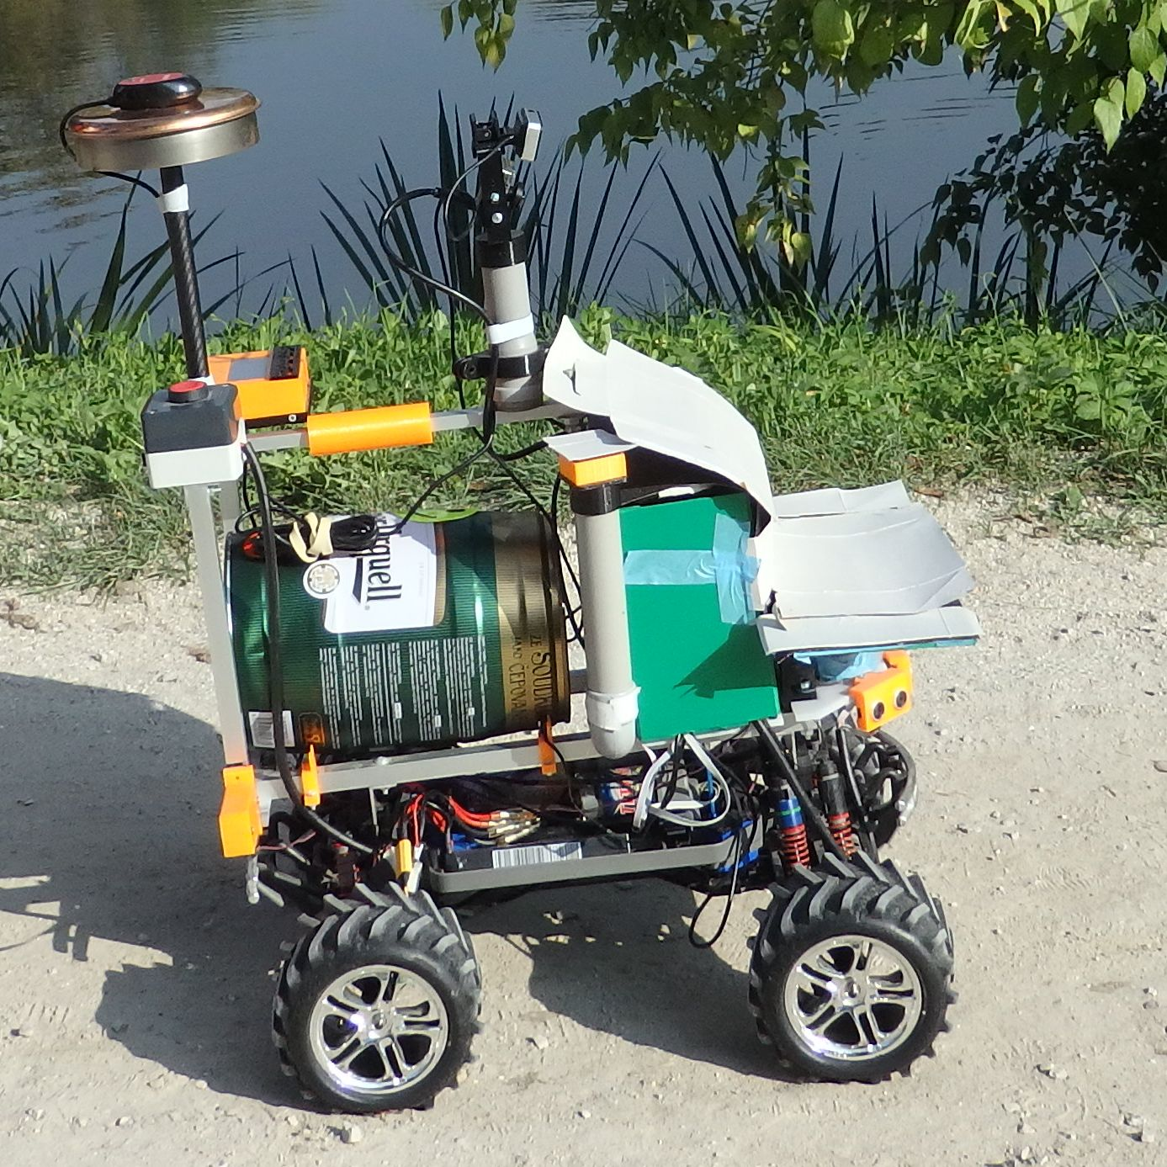
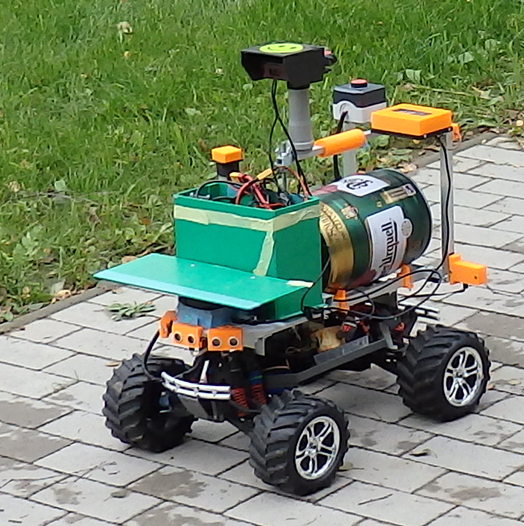
2016 2017 2018

Slide 3
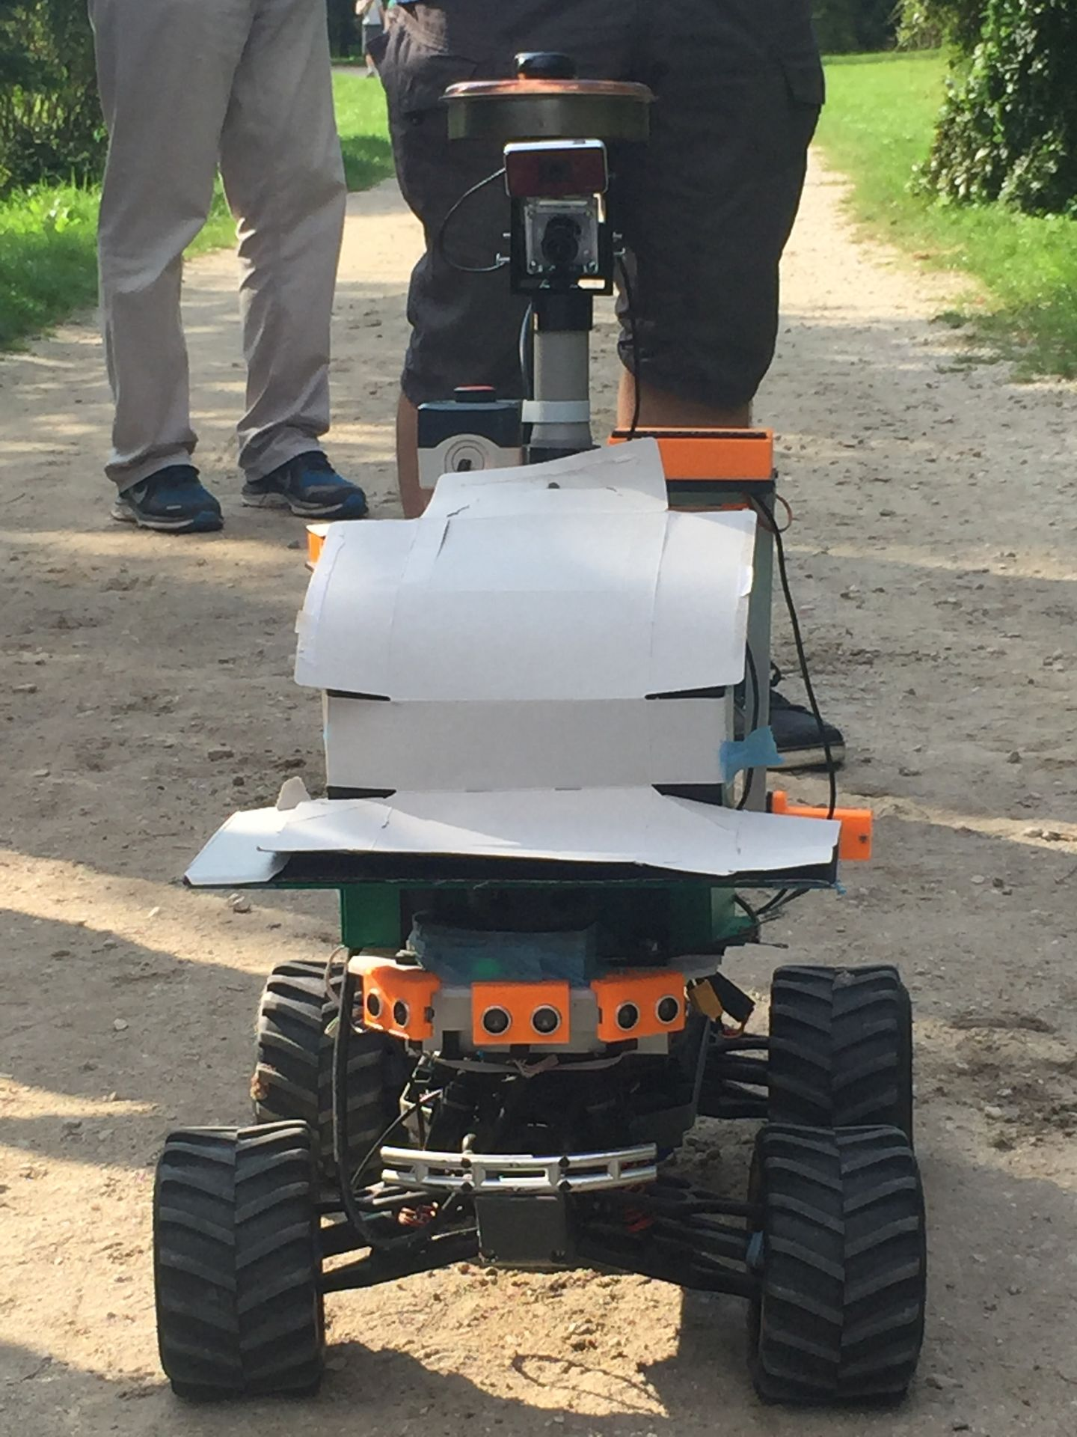
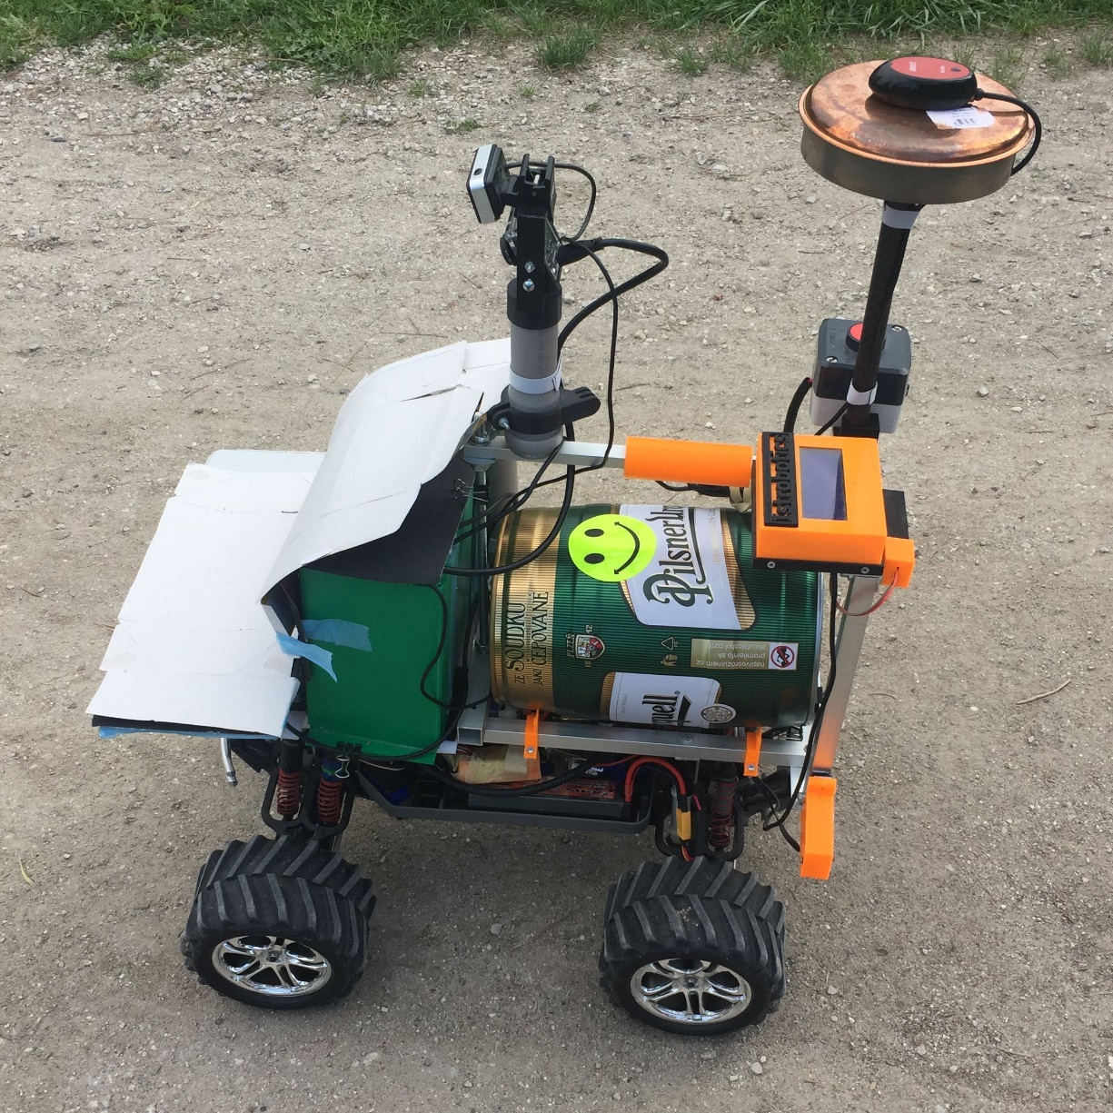

Slide 4
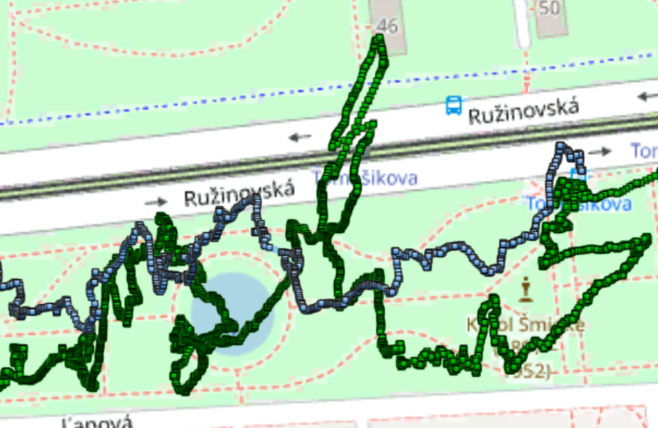
NEW GPS TESTS
Motivation: poor GPS performance last year
Old GPS (blue): MTK MT3333 GPS/GLONASS
Holux M-215+ Dual GNSS: GPS/GLONASS
-165dBm, 66 searching, 22 tracking channels
New GPS (green): Ublox NEO-M8 + Compass
Concurrent reception of up to 3 GNSS (GPS, Galileo, GLONASS, BeiDou)
–167 dBm, 72 channels, 30 tracking
Position: every 200ms
Issues: sometimes no course for more than 1s
Results: the same position accuracy (10-20m)

Slide 5
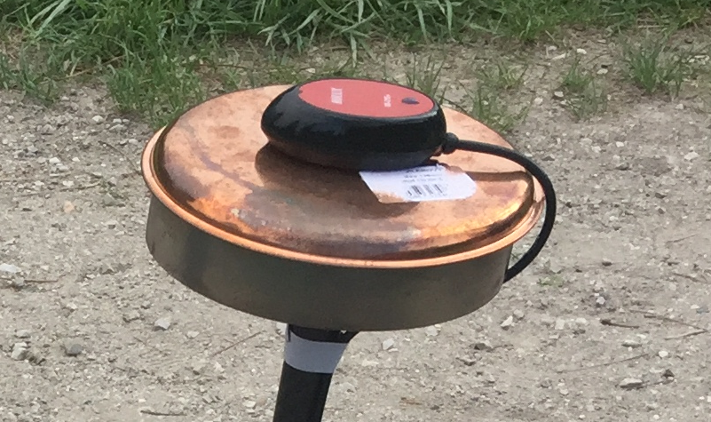
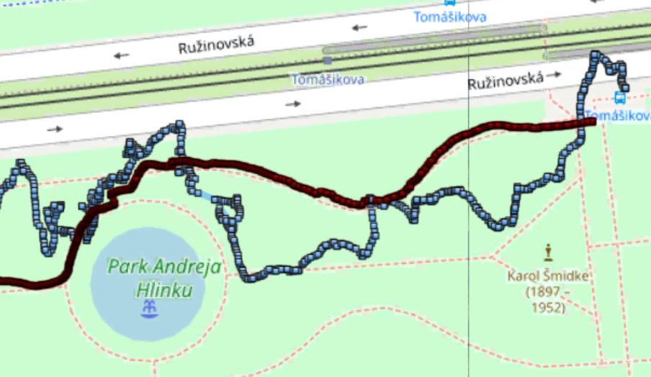
GPS GROUND PLANE
U-Blox GPS Antenna documentation
Patch antennas - flat surface is ideal
can show very high gain, if mounted on large ground plane (70x70mm)
USB 3.0 impact on GPS
Intel paper: USB 3.0* Radio Frequency Interference Impact on 2.4 GHz Wireless Devices
We used simple shield for GPS
Results: great improvement (3m accuracy)

Slide 6
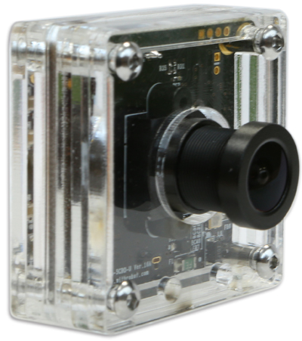
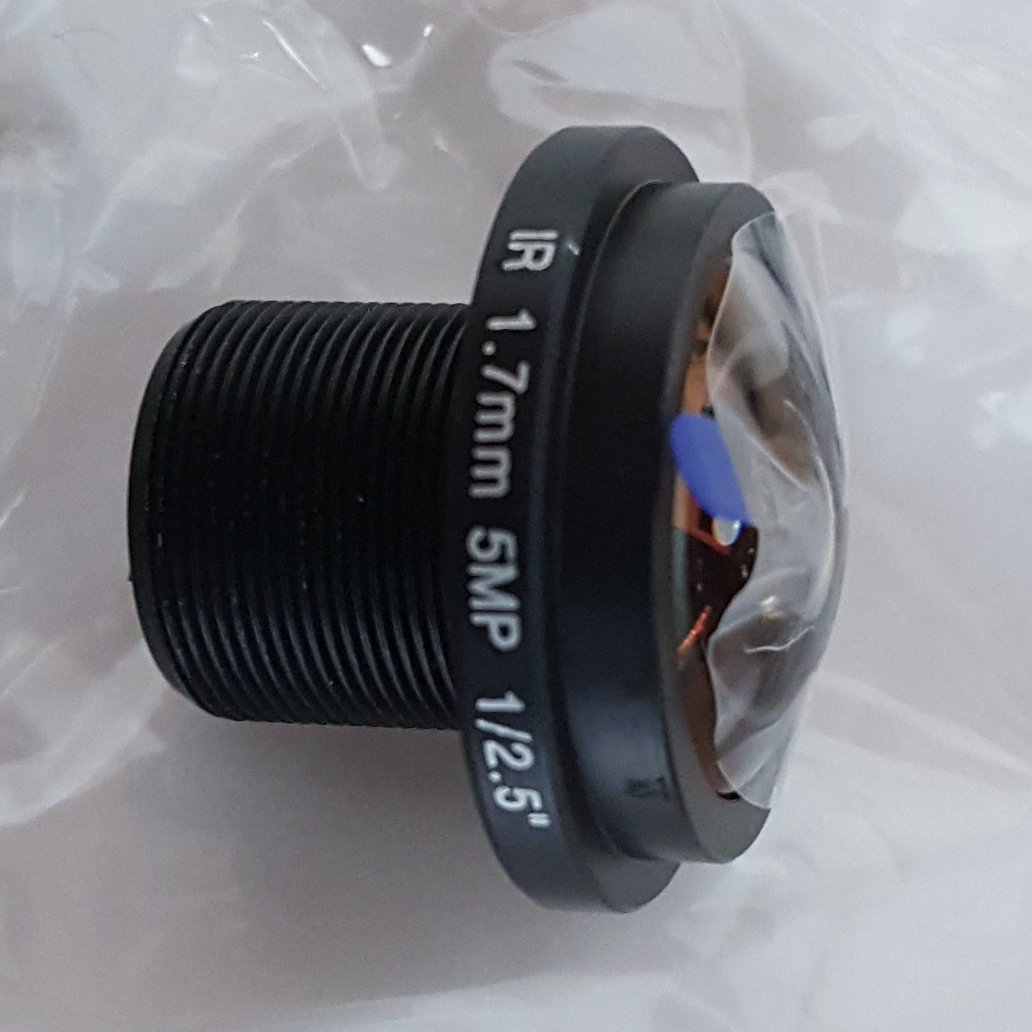
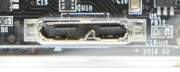
NEW 170FOV CAMERA
oCam : 5MP USB 3.0 Camera
OmniVision OV5640 CMOS image sensor
Original lens Field Of View: 65 Degree
Exchangeable Standard M12 Lens
Separate: 170 Degree Wide Angle
(standard accessory also for GoPro cameras)
we 3d-printed an adjustable camera holder (fixed by screws)
we broke the USB connector during the first test drive

Slide 7
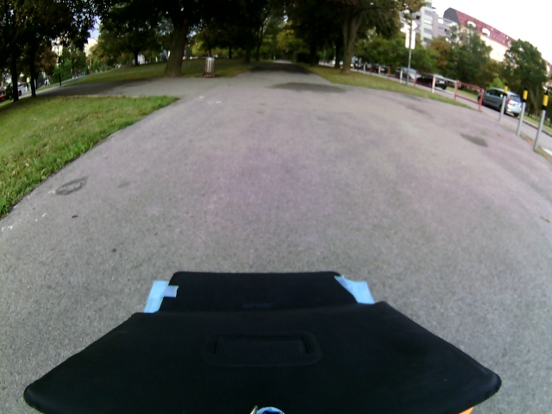
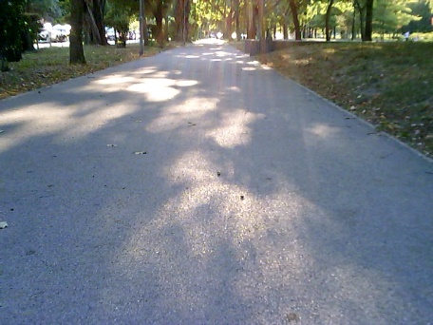
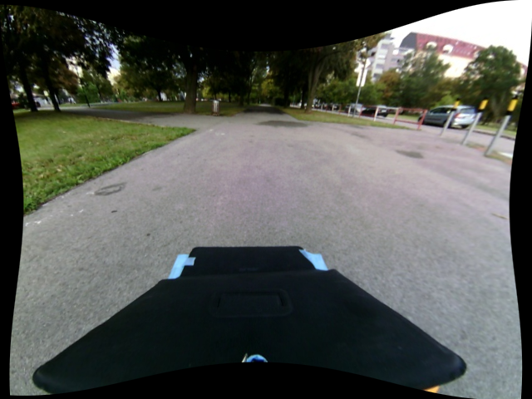
CAMERA CALIBRATION
Fisheye image warping correction
OpenCV supports Camera Calibration
cv2.calibrateCamera()
cv2.undistort()
Test in Python
execution times: 120-200 ms
Not used because of the performance impact
Better approach: correct only mapping between XY points and local map coordinates

Slide 8
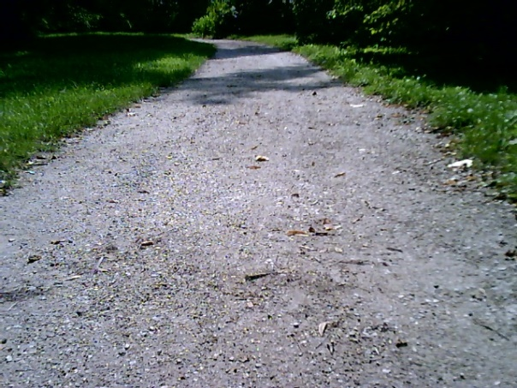
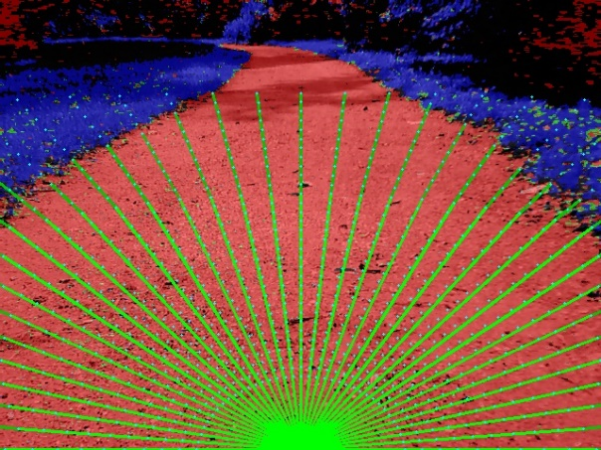
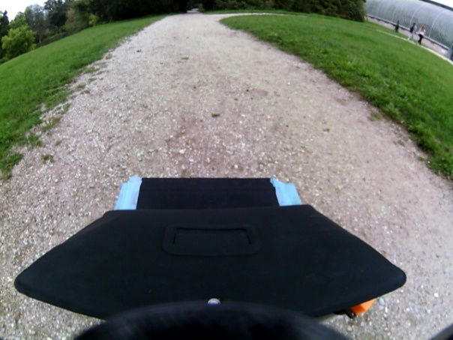
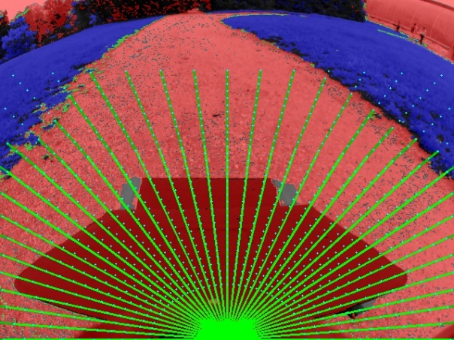
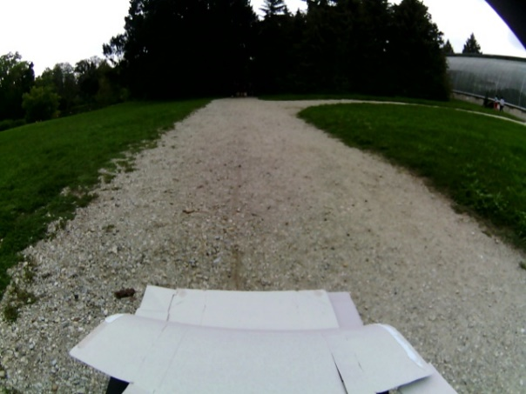
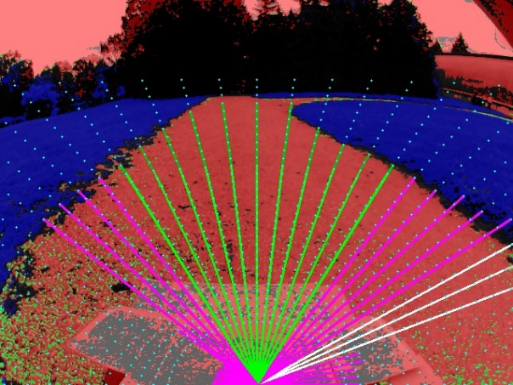
CAMERA ISSUES
Front side of the robot on every image
problem to paint it with the “road” color
solution: to be fixed by SW masking
Image is too dark
sun/sky causes high contrast images
our color maps did not work correctly
solution: use a shield to hide sky?
Roads appear too narrow
algorithm was not able to use GPS navig. on roads
solution: local-map geometry to be corrected

Slide 9



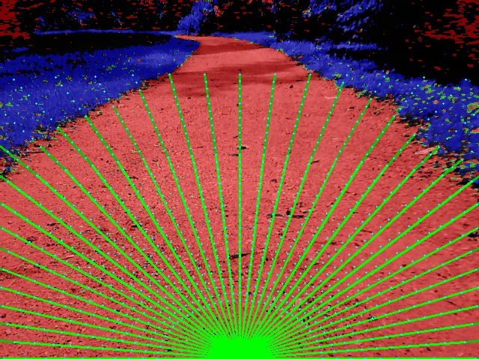



Slide 10
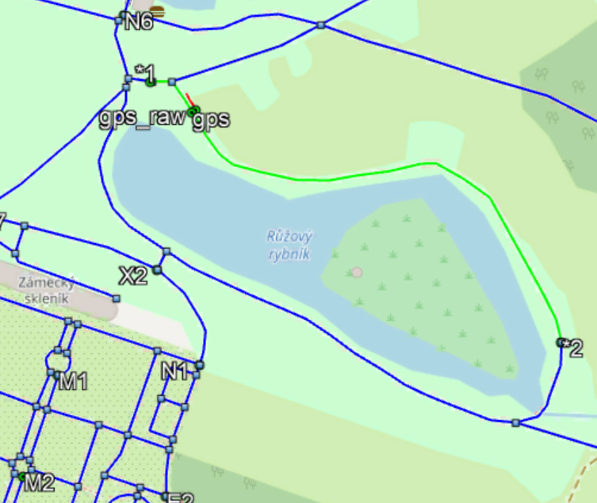
NAVIGATION – ROUTE PLANNING
OpenStreetMap data export
filter segments: footway, track with <grade3
Dijkstra's Shortest Path Algorithm
418 nodes, 504 segments
Performance: < 2ms
Visualisation: kml export, cpp export
Navigation: keep azimuth towards a point that is 10m along planned route

Slide 11
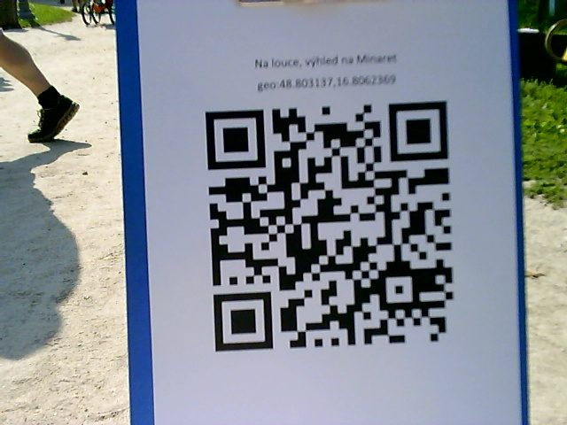

QR CODES
ZBar bar code reader
open source software suite
supports: EAN-13/UPC-A, UPC-E, EAN-8, Code 128, Code 39, Interleaved 2 of 5 and QR Code
Performance impact:
one execution: 50-200ms
our target 30-50ms per frame
Solution: images are scanned for QR codes only when waiting for navigation coordinates

Slide 12
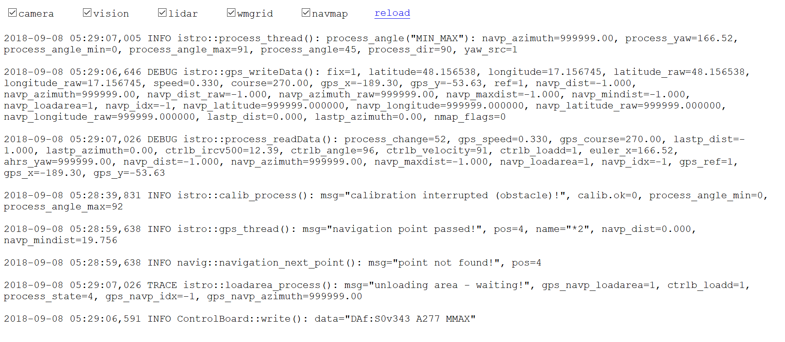
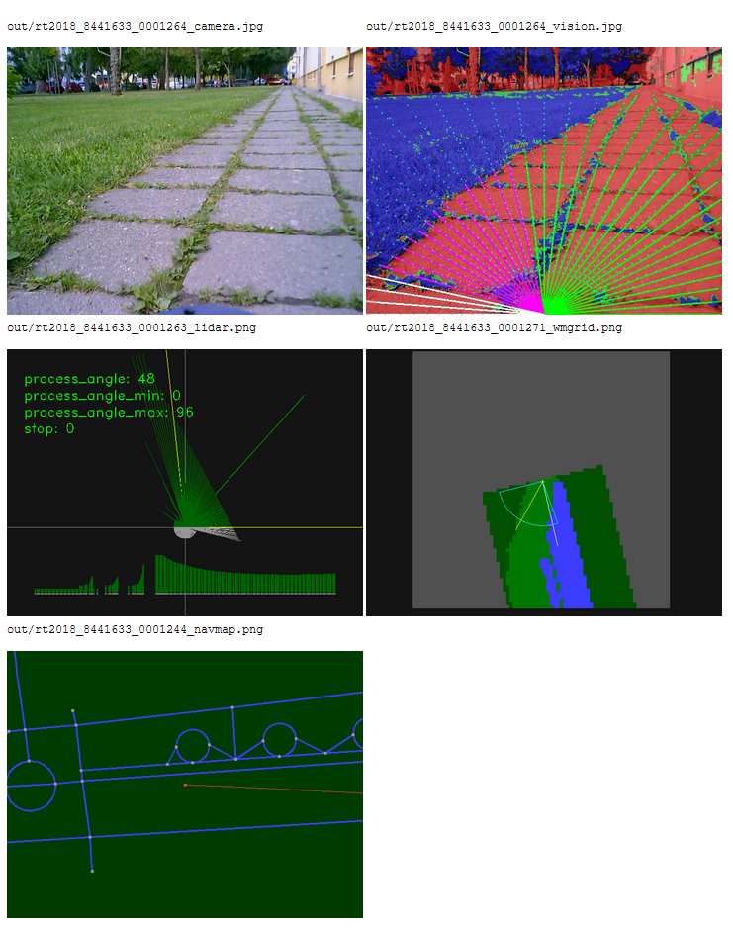

VISUALISATION
Visualisation in web browser
works on notebook/tablet/phone
Messages from log files
last set of lines matching selected substrings
Info: robot display, gps, processing, calibration
Log parser is exporting interesting data do .json file
Web page performs Ajax JSON requests every 1 sec
Images are only downloaded on demand (checkbox)

Slide 13
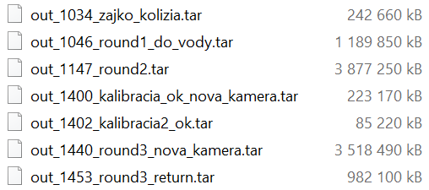
ROUND4 - DISK FULL
Round4 failure: we run out disk space
Flash storage capacity: 64GB eMMC
Storing to disk:
Log file
JPG, PNG, KML snapshots – 3-4 images/second
ROUND2 statistics
33 minutes, 28.000 files
Log file: 920MB (8.600.000)
Camera and vision JPGs: 6.500 each
Lidar and Grid PNGs: 6.000 each
Navigation KMLs: 1.500

Slide 14
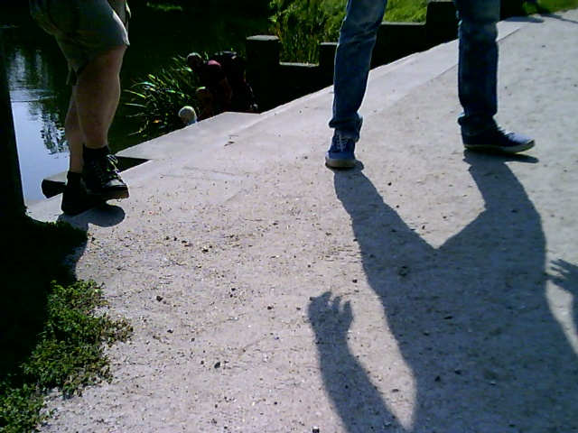
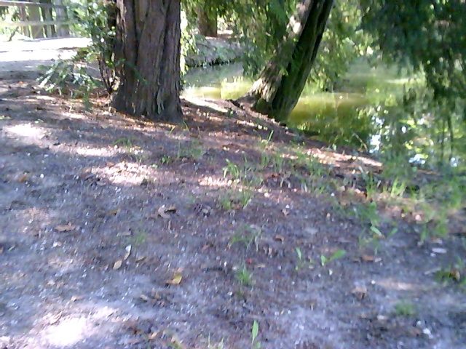
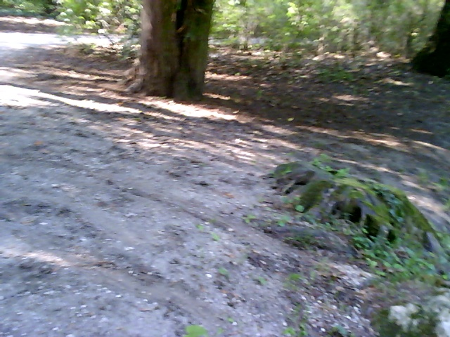
PROBLEMS
ROUND1 (successful loading):
not able to make a turn-around near lake
ROUND2 (successful loading + unloading):
turning out of the road based on navig. azimuth (no grass)
ROUND3 (failed before loading), new camera:
camera was pointing too high
sometimes not recognising road at all
SW bug in “wrongway” algorithm
ROUND4 (successful loading + unloading):
issue with disk full terminated the application

Slide 15
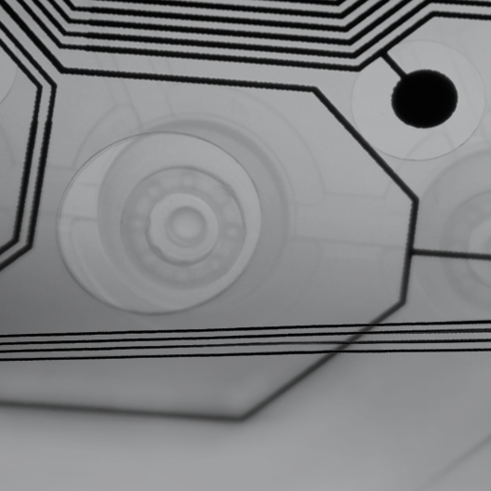
GENERAL SLIDES

Slide 16
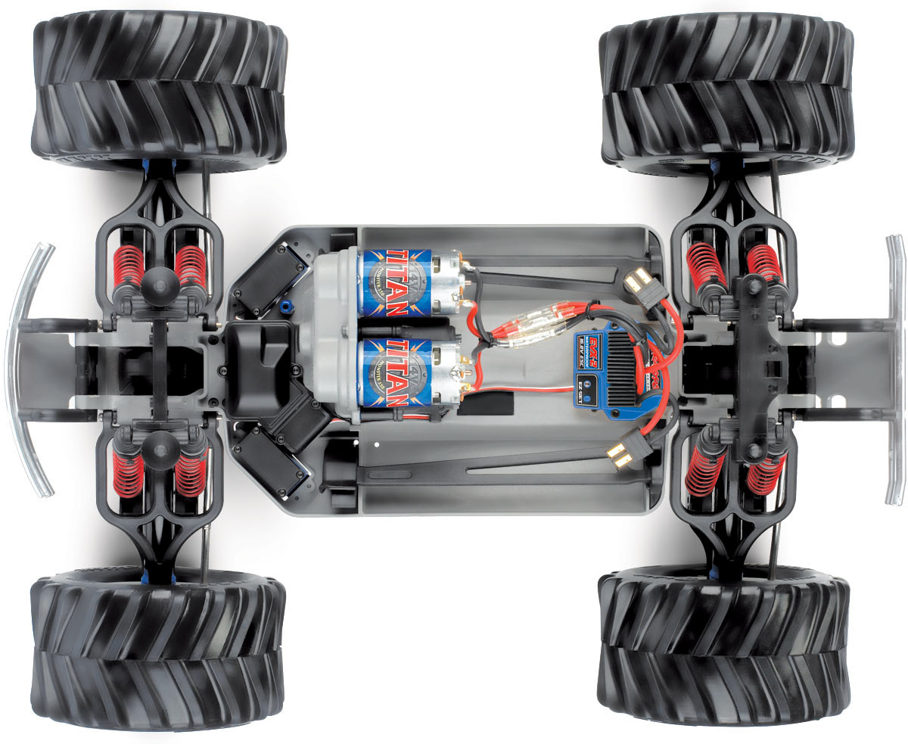
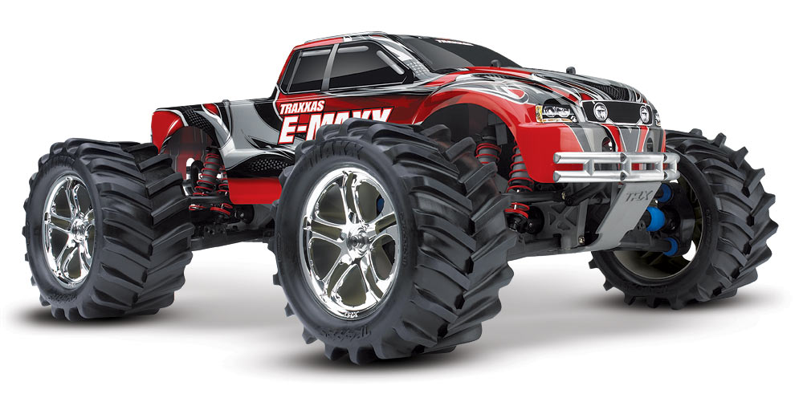
ROBOT CHASSIS
RC model: Traxxas E-Maxx 4x4 monster truck
Top Speed: 48 km/h
Waterproof electronics, servos

Slide 17
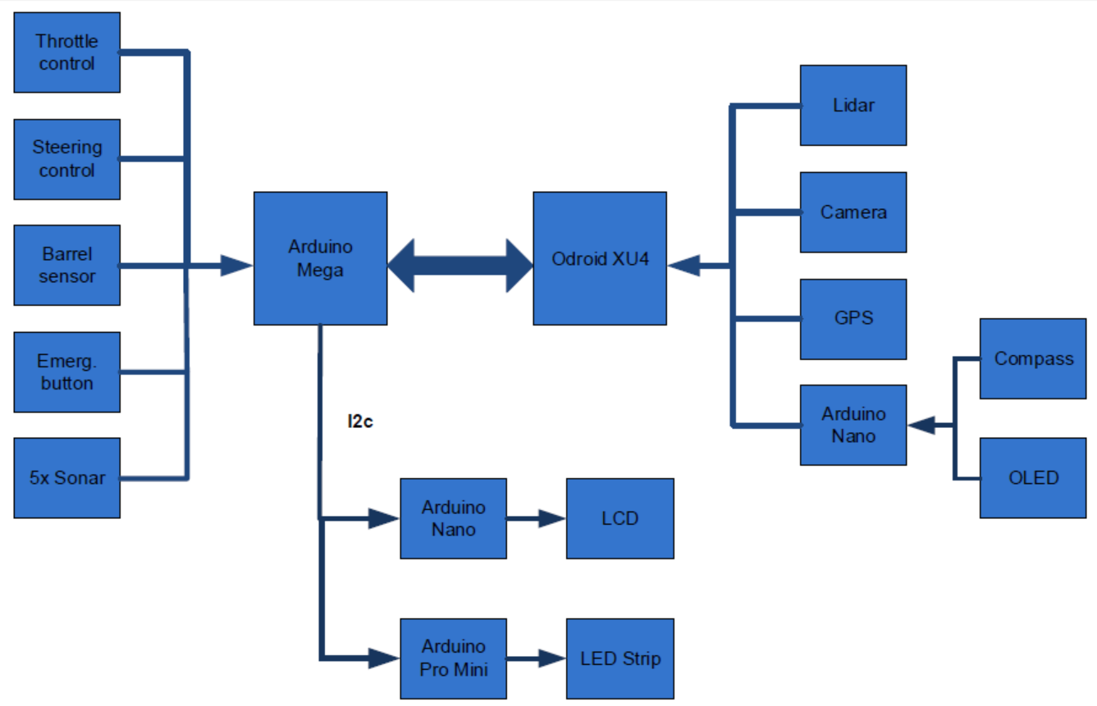
HARDWARE DESIGN

Slide 18
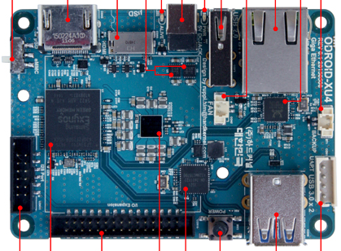
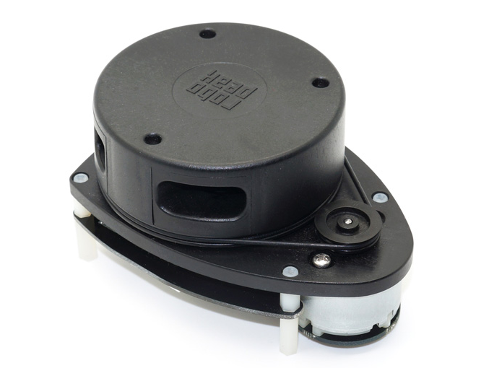
HARDWARE
Odroid-XU4: 2GHz 8-core, 2GB RAM, 64GB Flash
Arduino Mega: 16MHz, 8KB RAM
2x Arduino Nano: 16MHz, 2KB RAM
Arduino Pro Mini: 16MHz, 2KB RAM
2D Lidar: RoboPeak RPLIDAR 360 ($400)
Camera: Odroid USB Cam (640x480, 65 FOV)
Mouse type GPS/Glonass: Holux M-215+
Compass: Bosch BNO055
5x Sonar: HC - SR04
LCD & OLED displays, 8x LED

Slide 19
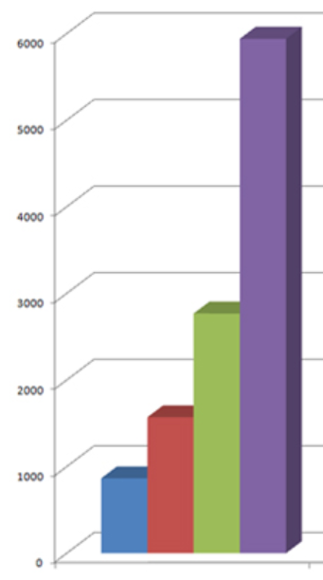
Odroid-XU4 vs Raspberry Pi3
 | Raspberry Pi3 | Odroid-XU4
CPU | ARM Cortex-A53 | Samsung Exynos5422 Cortex
Clock | 1.2 GHz | 2 GHz
Cores | 4x | 8x
RAM | 1GB LPDDR2 | 2GB LPDDR3
Flash | microSD | eMMC5.0 HS400
Ethernet | 10/100 Mbit | 1 Gigabit
USB | 4× USB 2.0 | 2x USB 3.0 1x USB 2.0
 | R-Pi2 | R-Pi3 | O-XU4
Image processing | 164,4 ms | 167,3 ms | 26,5 ms
JPG/PNG writing | - | - | 3x faster
Processing lag | 12 sec | 2 sec | 100 ms

Slide 20




SOFTWARE
Operating system: Ubuntu 16.04 Mate
Source codes: C++, 430kB
2017: 340kB, 2016: 180kB
Libraries: OpenCV (vision), GeographicLib (Geo), Zbar (QR-Codes), Libxml2 (.osm), log4cxx (logging)
Main application + 8x pthreads
4x sensors (Camera, Lidar, GPS , Compass)
image capturing + vision processing
output: image saving (1GB of data/ round)
control board (Compass)

Slide 21
SOFTWARE DESIGN – PROCESSING
UPDATE_GRID – VISION output UPDATE_GRID – LIDAR data
LIDAR data capture – 7x /sec
READ_SENSOR_DATA – gps, compass
every 20ms
CAMERA capture – 30 fps
Calculate NAVIGATION ANGLE
VISION processing – 35 ms
CHECK_GRID for obstacles
GPS data capture
OBSTACLE_AVOIDANCE – min/max
CONTROL BOARD comm.
COMPASS_CALIBRATION
WRONG_WAY behavior
SAVE images to disk – 3x /sec
NAVIGATION

Slide 22
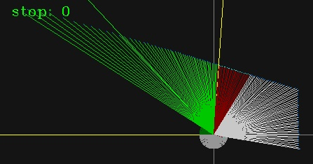
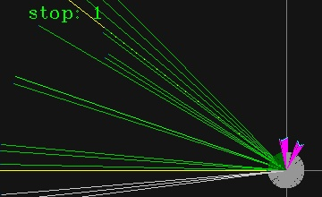
LIDAR – obstacle detection
Obstacle detection condition (red):
If distance is < 100 cm
Filtering: distance < 1cm (grey)
Stop condition (pink):
Check angle: -45 to +45 degrees
If distance is < 50 cm at 3 diff. degs
Sonars were also used (rain issue)
Obstacle avoidance (green/white)
Find OK intervals of > 20 degrees
Choose the closest to going straight

Slide 23
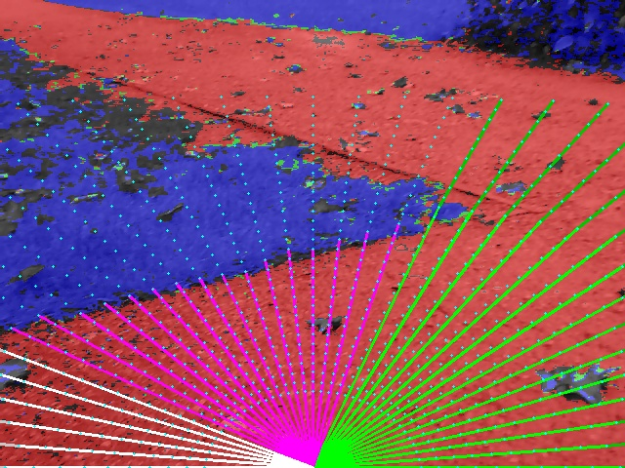
VISION – approach
Our approach: lidar-like local map
For any seen angle is obstacle closer than 1 meter?
1 meter or to the image border
Algorithm:
Pixel color classification
Evaluate grid points
Calculate distance to obstacle
Find OK intervals – same like LIDAR

Slide 24
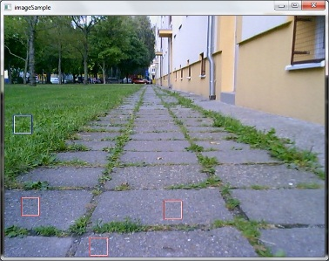
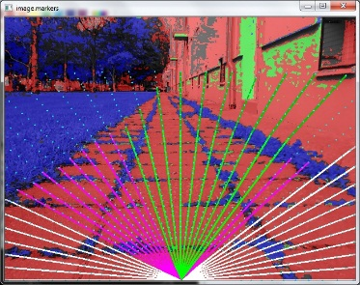
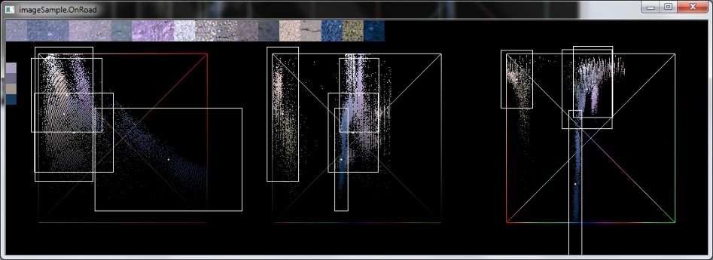
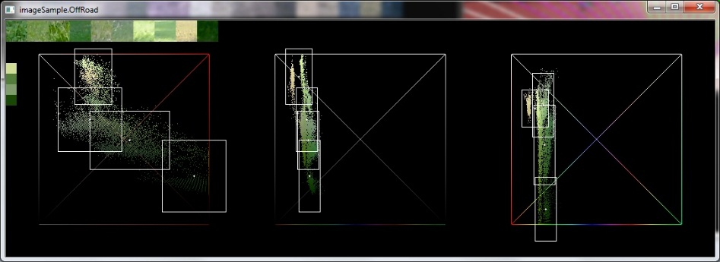
VISION – Pixel color classification
Approach:
Choose sample pixel blocks (32x32) from training images
Calculate 4 clusters centers in color space (OpenCV kmeans)
Calculate cluster radius (histogram based)
Repeat for 2 classifiers : road and off-road (grass)
HSV color space + Euclidian distance
Tool was developed - to define pixel blocks and evaluate images

Slide 25
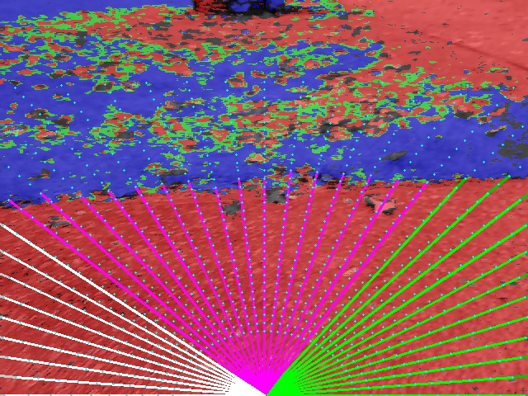
VISION – Algorithm
Pixel color classification - 4 results:
Road (red)
Off-road (blue)
Both (green)
None (grey)
Evaluate grid points
Cca 1000 points in 37 lines (5 deg)
Evaluating nearby pixels (80x80)
Majority of “Road” pixels is checked
Calculate distance to obstacle
Find OK intervals + merge with LIDAR

Slide 26
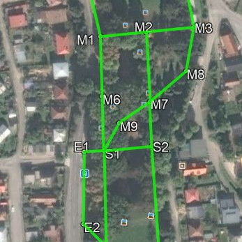
WAYPOINT NAVIGATION
Navigation points: 26 manually defined points
GPS positions taken from OpenStreetMap
Pickup and dropoff points in arrays (navig.cpp)
Navigation path – defined by a string “N2N1 *1 M4M5N7M3M8 *2 M7M2M3N7M5N3”
Compass calibration:
interval of 7 seconds - robot is moving straight
gps and compass azimuths to be fixed
performed every 30 seconds – 3 minutes

Slide 27
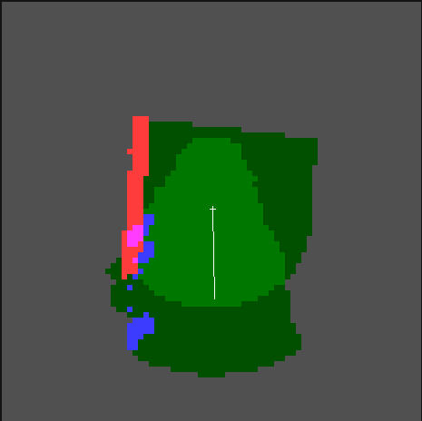
WORLD MAP – BUILDING LOCAL GRID
Local grid map
to store polar information from lidar and vision
1 cell: 10 x 10 cm, 1 byte pre cell, array[2000][2000]
always overwriting with new data - no heatmap
Local position taken from GPS + odometry
wheel encoders provide speed information
Colors used for visualization
Blue – grass (not-a-road) detected
Red – lidar obstacle
Green - no obstacle (light green = both sensors)

Slide 28
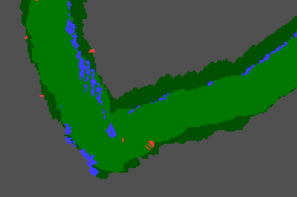

Slide 29
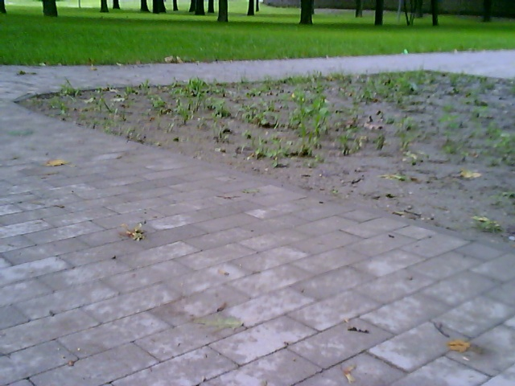
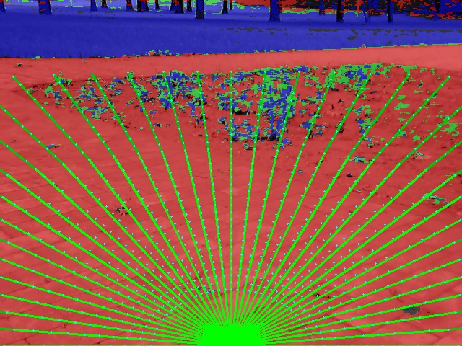
PROBLEMS – VISION FAILS DETECT ROAD

Slide 30

FREE SOURCE CODES
Sources codes are available at GitHub as public project Istro RT:
https://github.com/lnx-git/istro-rt

Slide 31
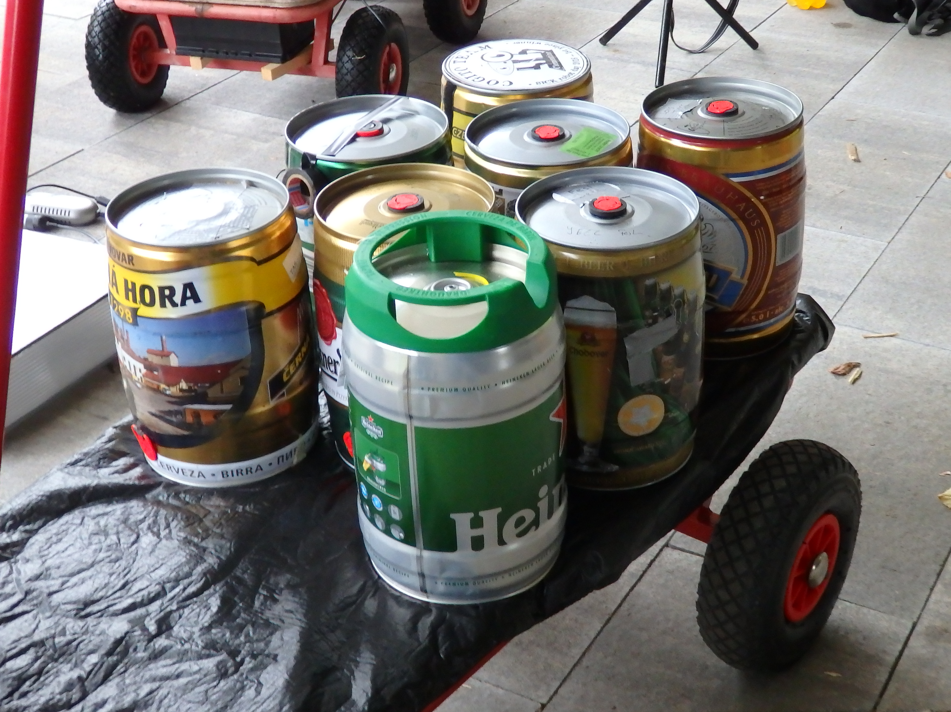
THANK YOU

